Slide 1
‘How to Guide’
Rapid Testing of Schools and ELC staff and senior phase pupils
COVID-19 National Testing Programme
This guidance was developed by The Scottish Government in collaboration with NHS Test and Protect and the UK Department for Health and Social Care. This guidance is for the following: staff in primary, secondary and special schools, senior phase pupils (S4-S6) and ELC providers. This is a working document, subject to change through the course of the testing programme.
Last updated: 03/02/2021

Slide 2
Contents
Overview
Step 1 – Read guidance, watch videos
Step 2 – Receiving your test kits
Step 3 – Setting up your collection point
Step 4 – Key Activities to run testing
Step 5 – Key messages for staff/pupils
Step 6 – How to report test results online
Step 7 – How to report incidents
Additional Resources
Get Support

Slide 3
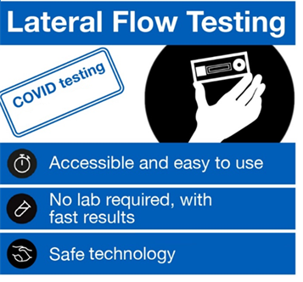

Who is being tested and why?
Overview
Testing is important because staff or senior phase pupils (S4 - S6) could be carrying the virus and may spread it to others. Testing staff and senior pupils without symptoms will support schools and ELC providers to continue to operate, as part of a wider package of mitigations.
Simple and quick tests using Lateral Flow Devices (LFD) enable the rapid testing of staff and senior pupils, from their home, without the need for a laboratory. Schools and ELC providers will be provided with these test kits to distribute.
The aim of this testing is to help break the chains of transmission by:
Carrying out twice weekly testing at home (3 to 4 days apart) before coming into the school/workplace in the morning
Maintain FACTS to help stay safe and protect others
IMPORTANT: Tests are only for the use of the person assigned the kits, they should not be taken by anyone else.
This asymptomatic testing programme does not replace current guidance for those with symptoms or those identified as a close contact of a positive case. Anyone with symptoms, whether they are involved in this programme or not, should book a free NHS test and follow government self-isolation guidance until the results of their test are known. People with symptoms must not rely on a negative LFD result to continue to attend school. Testing also does not replace basic preventative measures such as regular handwashing, PPE and social distancing.

Slide 4









Overview
Testing at home – the process
1
2
3
Consent to participate
Read key information and privacy notice to understand data protection for testing.
Collect test kits
Collect test kits from the collection point and take them home after signing for the updated instructions for use.
Test at home
Follow instructions: v1.3.2 issued with test kit – see slide 14. Test in morning before school/start of work ideally.
4
?
Check your results
At 30 minutes, check the result. Please note the results are invalid after 30 minutes.
Positive result: Self-isolate immediately and take a PCR test, following the current public health guidance
Void result: Take another LFD test. If you receive 2 void results in a row you should book a PCR test.
Negative result: No need to self-isolate, you can go to your workplace/school.
5
6
7
Report result to NHS self test - here
Even if negative or void
If positive result, Report absence to workplace/school.
Take next test
Take next test according to guidance - twice weekly, 3 to 4 days apart. Do not participate if you have had a positive PCR test in past 90 days.
It is recommended that staff and senior pupils test themselves in the morning before attending school/ELC (so there is less chance they get infected between taking the test and attending school). However, schools/ELC providers may choose to ask staff to do the testing the evening before, especially the first time, to give staff more time to get accustomed to the test, and to have more time as a school/ELC provider to react to a positive test result.
If you receive a positive LFD result you must book a confirmatory PCR test. We would advise visiting a community or drive through test site as this is the quickest way to get tested, or you can order a home test kit. It is important that you self isolate immediately and do not wait until the result of your PCR test.
Notes:
Slid

Slide 5

Overview
Governance
The LFD rapid tests do not require a clinician to deliver the testing. However, it is important to have clear responsibilities to ensure safe and effective testing.
PROVIDED BY DHSC / SCOTTISH GOVERNMENT
PROVIDED BY SCOTTISH GOVERNMENT/NHS
PROVIDED BY THE SCHOOL OR ELC PROVIDER
Clinical Standard Operating Procedure
Home LFD test kits
Instructional videos
DHSC central incident management helpline and mailbox (control@dhsc.gov.uk or tel: 0207 972 1000 - option 3)
NHS T&T result notification system (www.gov.uk/report-covid19-result)
Digital kits re-ordering system (in development, guidance to follow)
Issuing FAQs and best practice advice
Providing a link between local, regional and national response
Reviews and updates of the clinical Standard Operating Procedure (SOP) to ensure it remains appropriate for the programme in Scotland. This will include reviews by senior clinicians.
Linkage of data from the NHS self-test digital journey to the Test and Protect Central Management System (CMS) for initiating contact tracing on positive results.
Appropriate oversight and governance of testing at the school/ELC provider
Communication with staff and other local stakeholders
Obtaining consent to participate
Managing test stock and re-ordering
Setting up & maintaining Test Kit Log
Incident reporting and response including lessons learnt
Alignment with local public health response to COVID-19
To ensure testing is running well, we will be in contact with schools/ELC providers to follow-up on any incident reported and from time to time to find out how testing is going to learn any lessons. Guidance will be updated to reflect this.

Slide 6
Key questions
Overview
?
Why are we testing people without symptoms of COVID-19?
Some people who have coronavirus (COVID-19) do not display any symptoms.
?
Is this compulsory?
Testing is not mandatory. Staff and senior pupils should not be prevented from going into work/school if they do not take part. However, it is important to note that the success of this public health measure depends on as many people participating as possible.
?
How often do staff need to test?
Staff and senior pupils choosing to take part will test at home on a regular basis (twice per week, 3 to 4 days apart) usually before they come into work/school.
?
How effective are these tests?
LFD tests have been widely and successfully used to detect asymptomatic COVID-19 cases. The speed and convenience of the tests supports the detection of the virus in asymptomatic individuals, who would not otherwise have got tested. LFD tests are approved by the Medicines and Healthcare products Regulatory Agency (MHRA). The tests are highly specific, with low chances of false positives. They are also very sensitive and able to identify the majority of individuals who are infectious without symptoms (asymptomatic). It is important to remember that these tests are an additional layer of health protection measure in addition to the existing package of mitigations in place already, such as face covering, social distancing, etc.
?
Where do I get my test kits?
Test kits will be sent to primary, secondary and special schools and ELC providers, starting from 8 February. Testing should begin as early as possible thereafter for those staff or senior phase pupils who are attending school or ELC settings in person. If kits can be distributed for use prior to a return to school, this is encouraged.
?
Which early learning and childcare settings are included?
ELC staff who are based in settings located in schools will receive their test kits first. We are working through the practicalities of extending the programme to the wider ELC sector in the weeks after that. Staff in wider ELC settings can currently access testing through their employer.

Slide 7
Step 1 – Read guidance, watch webinars/video
Step 1: Read guidance, watch videos
You should read the guidance that is available on the Objective Connect document sharing platform. This includes the foundational document for the programme, the Standard Operating Procedure, which those leading testing in schools should familiarise themselves with.
An instructional video is provided for those taking the test: Step by step guide to COVID-19 self-testing – YouTube
Updated 19/02/2021: Following feedback from schools about the difficulties of attending webinars for many staff during school holidays, the Scottish Government and the UK Department of Health and Social Care have recorded an introductory video presentation for primary, secondary and special schools and ELC providers that will provide information on the overall testing process and answer some of the most commonly raised issues to date
The video is available via Objective Connect, or by accessing it on Vimeo at the following link and using the following password:
    Link: https://vimeo.com/513768753
    Password: q0SBt+Gj
All other resources such as templates are available via the following link: https://secure.objectiveconnect.co.uk/login
The resources available will be the most up-to-date versions.

Slide 8
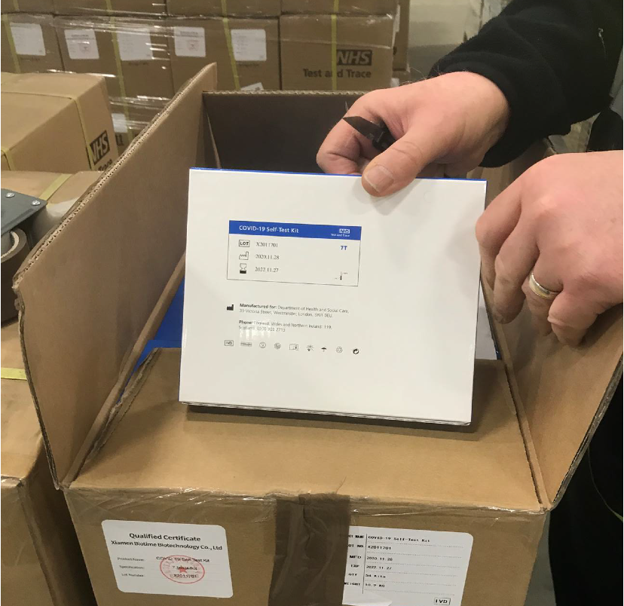
Step 2 – Receiving your test kits
Step 2: What you will receive and when?
Schools - Test kits commenced delivery from w/c 8/15 Feb for testing to start as soon as possible thereafter. Deliveries for staff and Pupils in S4-S6 are being made in w/c 8 March. Test kits for pupils in S1-S3 will be provided to schools w/c 29 March and 12 April, depending on school holidays.
Kits are expected to be delivered by Brakes or Bidfood (depending on existing contracts) along with regular, scheduled catering deliveries. If no catering delivery is scheduled, distributors will still make a dedicated delivery of test kits during normal school hours. A delivery schedule will be provided to local authorities for onward communication to schools. If schools are closed at the time of delivery, local authorities have been asked to work with schools to ensure someone is exceptionally onsite to receive delivery, to avoid delays to test kits being delivered. On arrival, please record the lot number(s) of the test kits delivered.
Email control@dhsc.gov.uk or tel: 0207 972 1000 - option 3 if your test kits do not arrive or are damaged. NB: ELC settings that are not located in schools will receive their deliveries later than this. Further advice will follow.
Delivery parcel size
Tests will initially come in boxes of 7 tests for staff (each large carton containing 54 boxes of 7) and boxes of 3 for senior phase pupils (each large carton containing 108 boxes of 3).
The picture shows an outer case and an example of an LFD 7’s test kit
NB: In addition to a box of test kits there will be a bundle of updated Instructions for Use that must be given out with each kit (version 1.3.2)
There will be a sufficient number of kits for two months of testing. You can initially provide 1 box of 7 testing kits to each member of staff, and 3 boxes of 3 testing kits to each senior phase pupil so that they can test twice a week.
We will provide further advice on Objective Connect (https://secure.objectiveconnect.co.uk/login) on how to re-order test kits in due course.

Slide 9
Step 3 – Setting up your collection point
Step 3: Set up your collection point
The collection point does not need any extra infrastructure. However, it must:
Be able to be secured to prevent unauthorised access to the test kits, such as the staff room.
Not be outside. The test kits need to be stored in temperatures between 2 and 30 degrees.
Allow enough space for social distancing when handling or distributing test kits, etc.
The member of staff coordinating the handing out of the test kits should wear an appropriate face covering at all times and maintain 2m from staff coming to collect their test kits.
Each school / ELC provider participating in self-testing should undertake a risk assessment prior to starting testing and continue to maintain this on their risk register. This should cover risks associated with testing, non-reporting, poor uptake, communication etc.
IMPORTANT:
Before distributing any test kits to staff or senior phase pupils you need to set up a ‘Test Kit Log’ (see slide 13) and ensure you have the correct Instructions For Use to hand out (see slide 14).

Slide 10
Step 4 – Running your collection point
Step 4: Key activities to run testing
The administrative requirements for schools and ELC providers are relatively light as tests will be conducted at home. You’ll need to identify some support to carry out some key activities, outlined below.
You must have a Covid Coordinator to support with tasks such as:
You may also need a Registration Assistant (can be the same person if needed) to support with tasks such as:
communicating with stakeholders
obtaining consent to participate
ensure staff are using the right instructions and that they sign for the test kits using the ‘Test Kit Log’
reporting incidents and carry out risk management
storing and reporting any required data
reorder tests when required (advice on how to do this will follow)
Ensure privacy information is provided to staff and pupils at the outset of any testing programme.
maintaining a register of participants who have provided consent
distributing the correct number of test kits to staff and managing the schedule for the distribution of the next sets of kits
sending reminders to participants to record their results online
responding to staff questions
working with the Covid Coordinator to manage the stock of kits.
The registration assistant should wear an appropriate face covering when giving out the test kits, and ensure social distancing of 2 metres is maintained.

Slide 11
Step 5 – Key Messages for Staff and senior pupils
Step 5: What do you need to tell your staff/ pupils?
1
Tell them what rapid testing is, using the guidance and resources available on the document sharing platform.
2
Use the next slide ‘Participation and Data Protection’ and the links on that slide to discuss any concerns they may have about testing at home.
3
Tell them who is acting as the COVID Coordinator and Registration Assistant (this can be the same person)
Explain that they will need to sign for their test kits and record the lot number on the box of their test kits against their name.
4
5
Let your staff and senior pupils know how they can collect their test kits. And use the ‘Instructions for Use’ slide in this section to make sure they collect and use the correct instructions when testing.
6
Make sure your staff and senior pupils know it is a requirement for them to report their test result to the NHS via the relevant website (www.gov.uk/report-covid19-result). Use the “Reporting your test result online” slide in this section.
7
Make sure your staff and senior pupils know who to contact if they have an incident while testing at home. Use the “incident reporting” slide in this section.

Slide 12
Step 5 – Key Messages for Staff and senior pupils
Participation and Data Protection
All participation in testing is voluntary
For staff, consent for testing is required (by returning the form) having read the instructions and understood the implications of going ahead with the test.
For senior phase pupils, consent from themselves (if 16 or over, after discussing with parents/carers or guardians) or parents/carers or guardians (if under 16) is required for participation. Individual pupils can opt in or out at the point of collecting kits each week.
Eligibility criteria for testing includes individuals who:
Are asymptomatic (who do not have symptoms)
Have read the privacy notice to understand what will happen with their data. A template privacy notice can be found on the document sharing platform.
Have provided consent to participate (returned the form)
Have not tested positive with a PCR test in the past 90 days.
Individuals who decline to participate in twice weekly testing may still attend school/ELC provider in line with national guidance.
Staff and senior pupils who decline to participate in the programme should still be able to attend school/ELC provider providing they have not come into contact with a positive case (close contact), developed symptoms or received a positive Covid-19 test result outside the programme.
However, staff and senior phase pupils are encouraged to participate in the programme, to contribute to the wellbeing of their school communities.

Slide 13
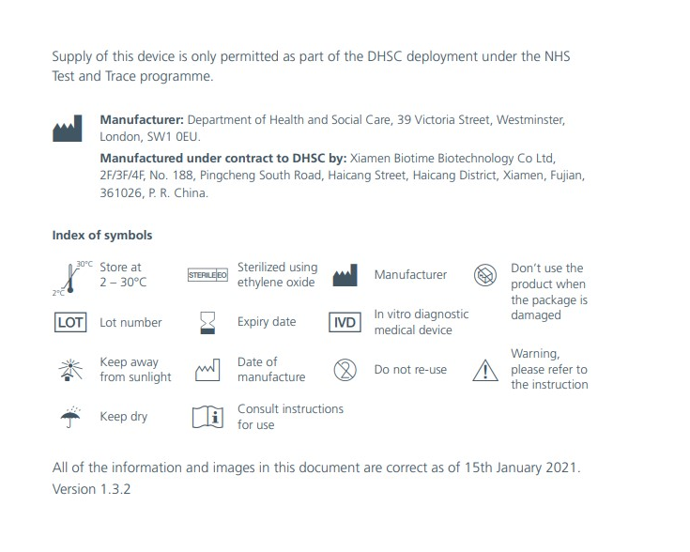
Step 5 – Key Messages for Staff and senior pupils
Sign for the test kits
Schools and ELC providers should record who takes test kits, using the lot number on the back
When issuing the kits to staff and senior pupils, the issuer must record who takes the test kits. This is the Test Kit Log and must include:
Name of school / ELC provider
Name of person issuing the test
Date of issue
Lot number of test kit
Confirm receipt of new Instructions For Use (IFU)
Name of person using the test
While not a regulatory requirement, the Scottish Government also recommends the inclusion of the following field to help reinforce the importance of regular testing and reporting, and to identify any difficulties in using test kits:
Number of previous tests issued that have been completed successfully, (ii) number that were void, and (iii) have all results been reported to the NHS via the digital portal?
Back cover
You may also wish to merge your consent record with the log to ensure test kits are only given to those who have consented.
Please use the template Test Kit Log, which can be found on the Objective Connect document sharing platform.
The Log should be kept for 12 months from the date of the last entries made by the school. The UK Department of Health and Social Care may from time to time request that you share this log (or extracts from it) to assist in monitoring and responding to issues with test kits.

Slide 14


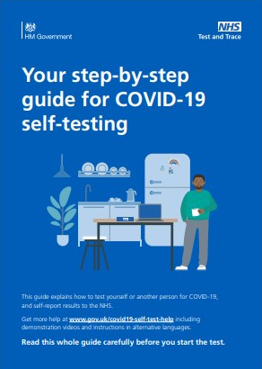

Step 5 – Key Messages for Staff and senior pupils
Hand out Instructions for Use – v 1.3.2
Schools and ELC providers will receive an Instructions for Use (IFU)
We are legally required to supply test kits with the right Instructions for Use.
You will need to ensure the correct Instructions for Use (with a plain blue cover, and dated 15 January 2021 v 1.3.2 on the last page of the printed instructions) are given to staff members and senior pupils.
The old instructions are inside the box of test kits. The most up-to-date instructions come in a separate bundle. Please inform participants that the separate document replaces the instructions inside the box.
Old front cover
New front cover

Slide 15
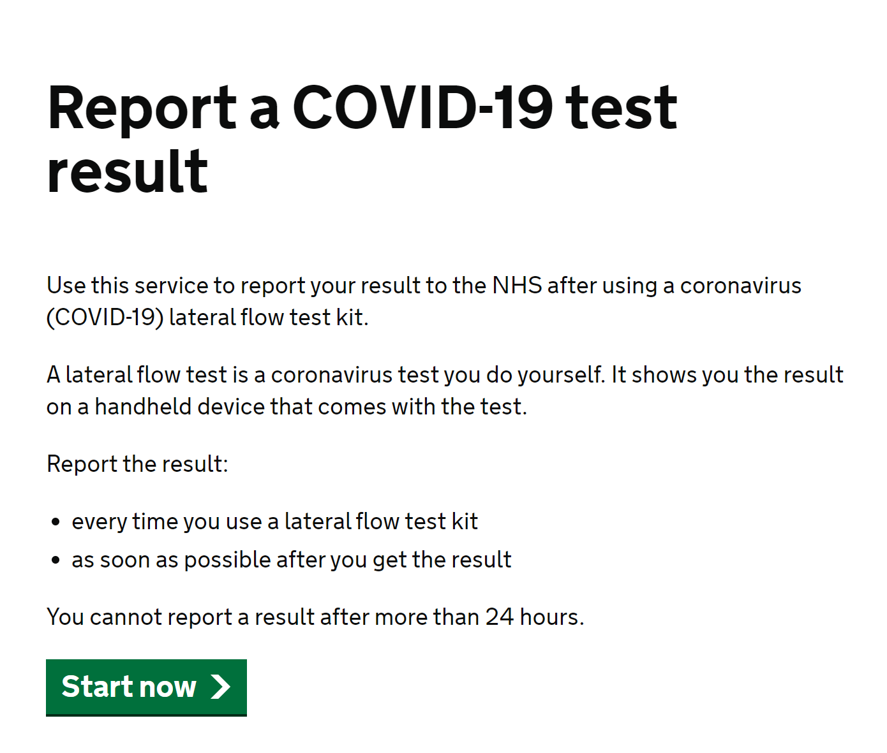
Step 6 – How to report results
Step 6: How to report test results online
Test subjects are required to report the results of their tests online, every time they take a test, even if the result was negative or void.
Schools and ELC providers are not able to view the results that their staff or school senior pupils have uploaded to the online service.
Individuals who receive a positive result should start isolation immediately and order a confirmatory PCR test. They should notify their workplace of their absence.
Staff and senior phase pupils are also strongly encouraged to report positive test results directly to their schools/ELC providers in line with local arrangements, to support effective contact tracing.
Contact tracing should begin when a positive LFD test result has been received.

Slide 16
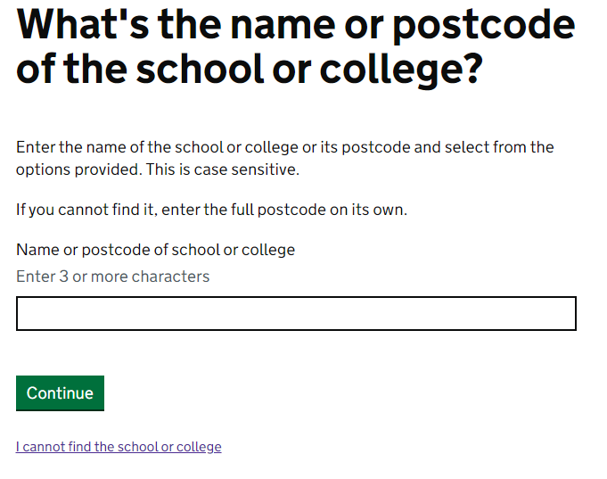
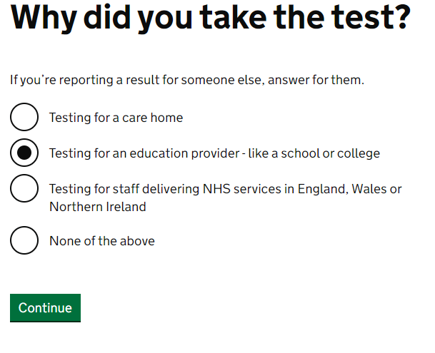
Step 6 – How to report results
To report results using the online portal at www.gov.uk/report-covid19-result:
- Users can now create an account to save their information.
- Users should select “Testing for an education provider – like a school or college” when asked why they took the test.
- NB: Participants may need to know the postcode of their school to use the portal.
- Scottish schools are currently being added to the digital portal at www.gov.uk/report-covid19-result.
- If you cannot find your school, please click “I cannot find the school or college” and add information manually. If your school is still not listed by w/c 22nd February, please contact control@dhsc.gov.uk.

Slide 17
Step 7 – Reporting Incidents
Step 7 - Incident Reporting
If there is a clinical incident which led to, or has potential for, harm (e.g. swab breaks in the mouth, bleeding, allergic reaction on using the kit, etc.), individuals will be advised to “raise a yellow card” and report it on: https://yellowcard.mhra.gov.uk/
For incidents occurring at a home setting, participants will be advised to report any issues (e.g. non-clinical: something damaged, or missing or difficult to use in the kit, etc.) by calling 0300 303 2713 for Scotland
Medical care should be sought through the usual route of contacting 111 or 999
Schools and ELC providers are also advised to report incidents (e.g. multiple staff not reporting positive results; reports from staff of multiple voids e.g. all voids in one pack or sudden overall increase in void reports, breakage and other issues with testing kits etc.) to control@dhsc.gov.uk or tel: 0207 972 1000 - option 3

Slide 18
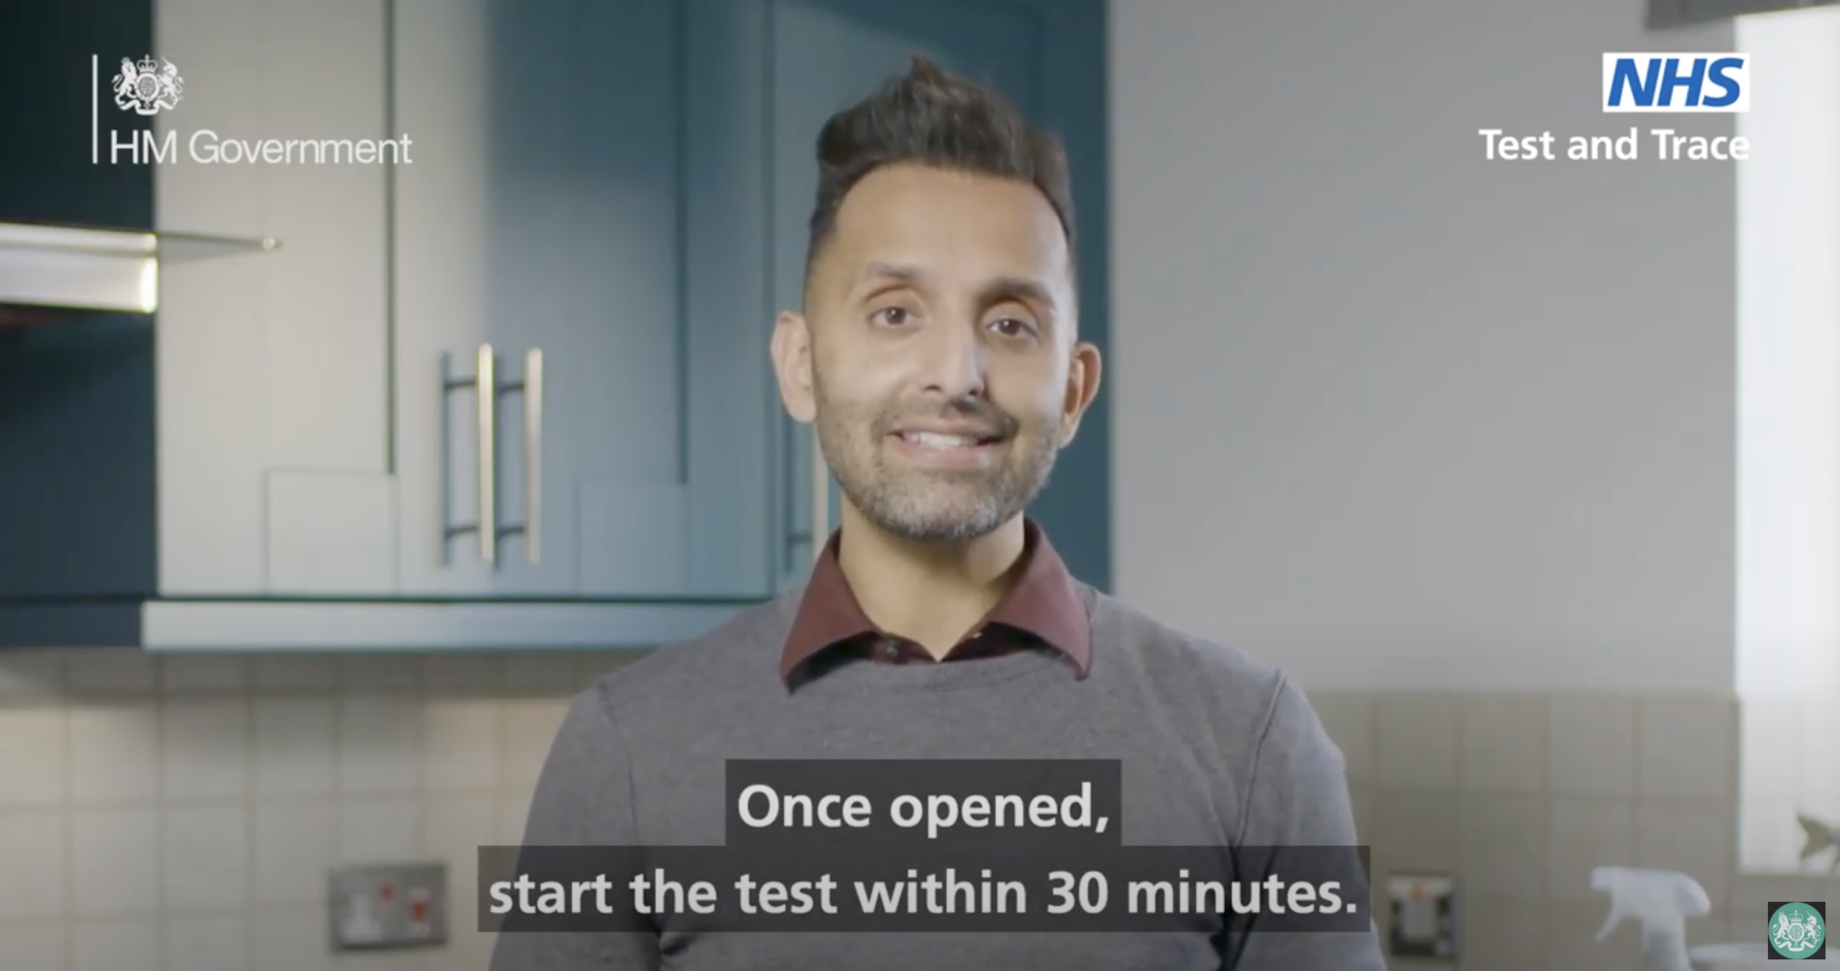
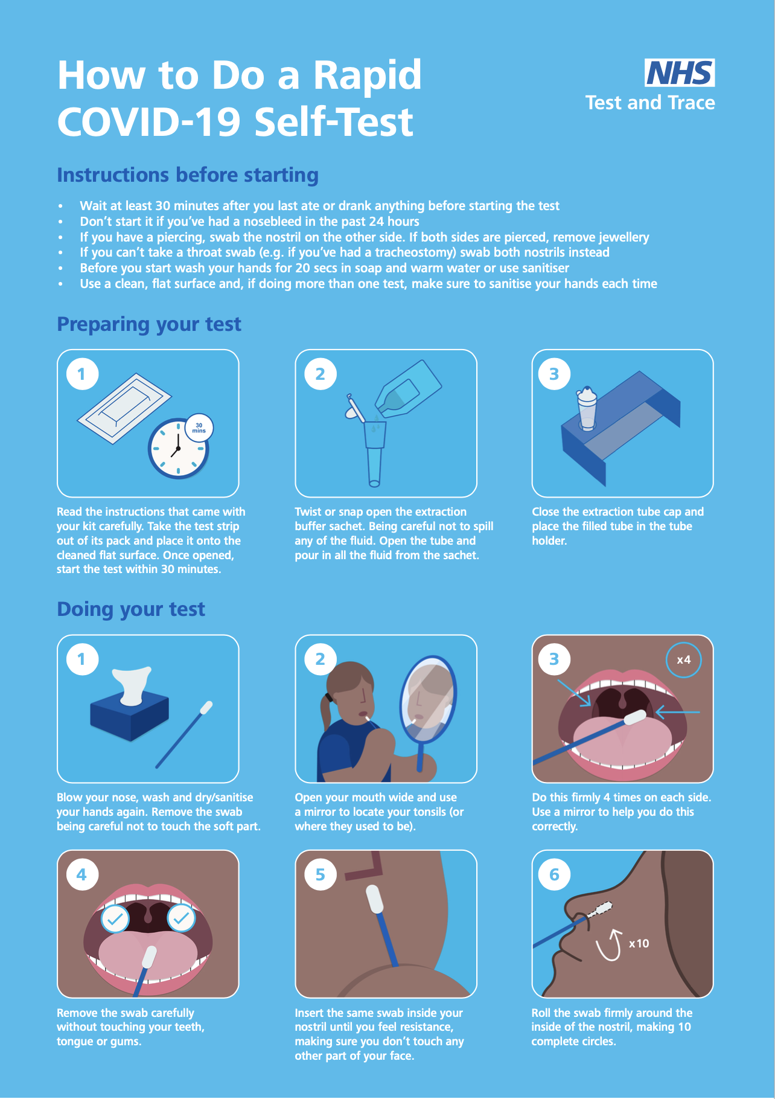
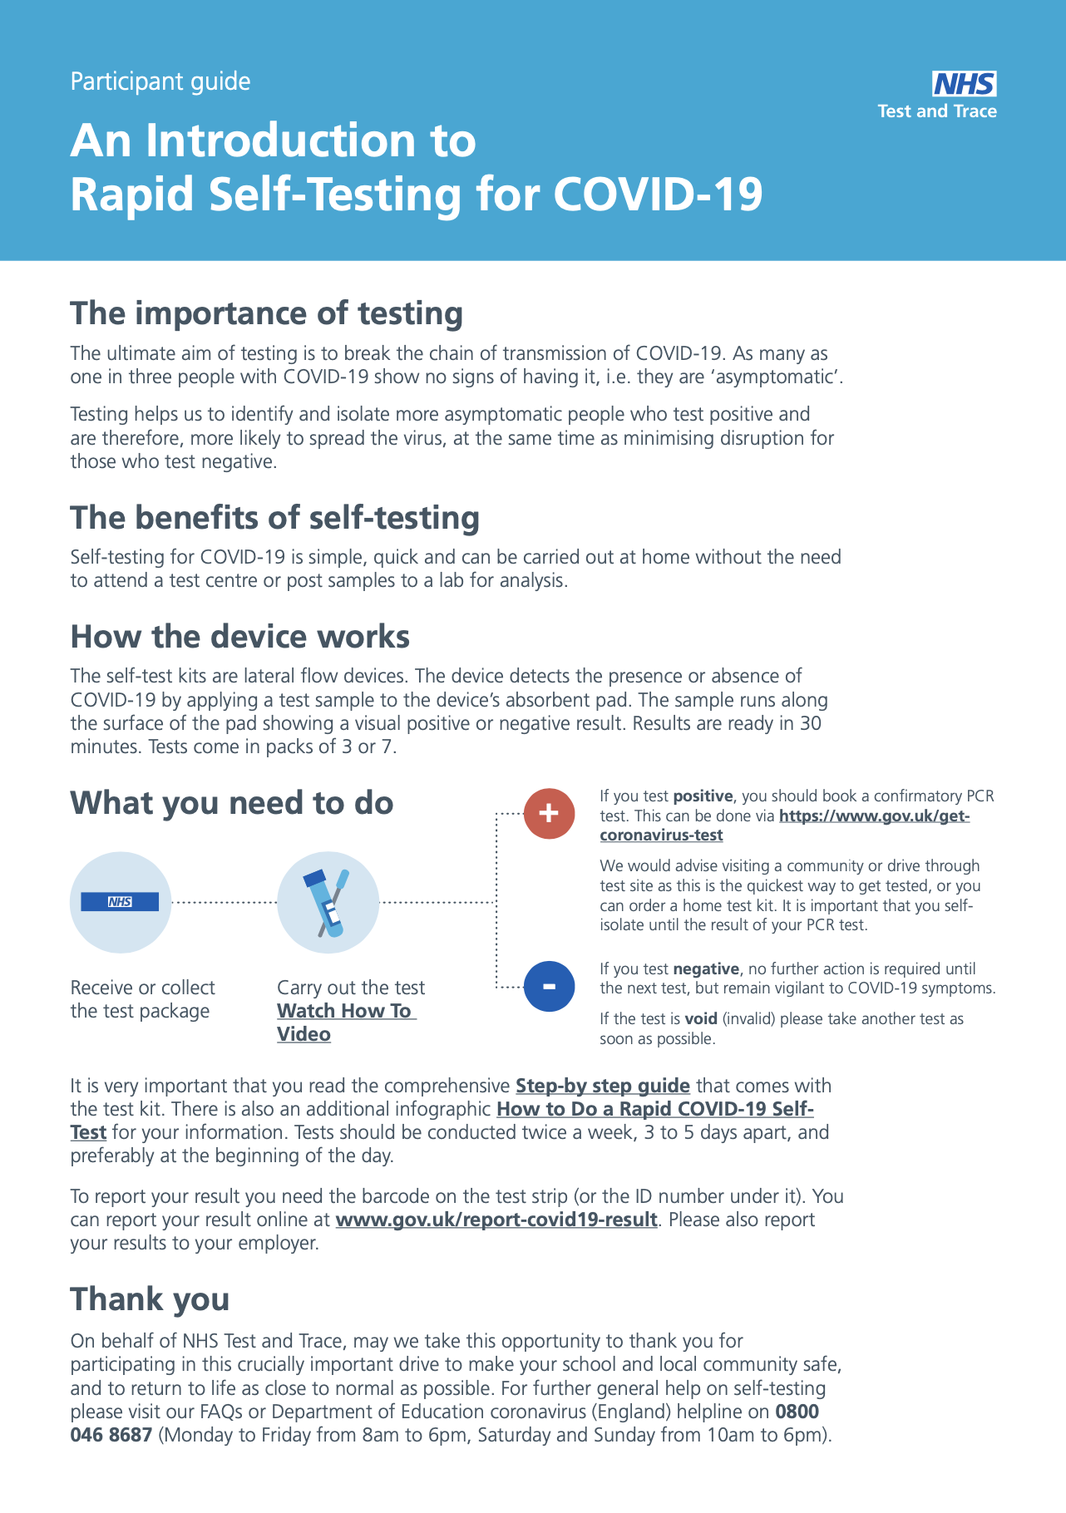
Additional Resources
You can find the latest guidance on the Objective Connect Document Sharing Platform
You’ll have access to FAQs, guidance on ordering kits, and advice on keeping your own test kit log - amongst other materials.
You’ll also find the following resources which will be useful for staff taking part in testing:
an introduction to rapid self-testing
an NHS video demonstrating how to carry out a test
a step-by-step visual guide on how to do the test
If you are having problems accessing Objective Connect, please contact schoolscovidtesting@gov.scot

Slide 19
Get support
Schools and ELC providers in Scotland can raise questions, concerns or report issues by emailing control@dhsc.gov.uk
or tel: 0207 972 1000 - option 3.
Anyone with one or more of symptoms of coronavirus
A high temperature, a new continuous cough, or a loss or change in sense of smell or taste, should self-isolate and book a test or call 0300 303 2713.
Incidents occurring at home
For incidents occurring at a home setting, individual participants will be advised to report any issues (something damaged, or missing or difficult to use in the kit, unable to log result etc.) to 0300 303 2713 for Scotland.
If you have an urgent media query
Or if you, your school or your ELC setting is approached by a member of the media, you can contact the Scottish Government media enquiries portal for support.​

Slide 20

20
© Crown copyright 2021
This publication is available for reuse under the terms and conditions of the Open Government Licence v.3, available for download here: http://www.nationalarchives.gov.uk/doc/open-government-licence/version/3/

